Slide 1




Mini project
Roll no -
24030
24031
24032
24033

Slide 2


What is the project?
Our project is about understanding and comparing two digital signature methods — the Digital Signature Standard, or DSS, and the Schnorr Signature in a simplified ‘toy’ version. The main goal is to show how digital signatures help verify the authenticity of digital messages and documents.
We used smaller, easy-to-follow examples to explain how these signatures are created and verified.
Digital signatures are really useful because they provide data integrity, meaning the message hasn’t been changed; authentication, so we know who actually sent it; and non-repudiation, which means the sender can’t deny signing it later.
They’re widely used in secure emails, online transactions, e-commerce, and software updates, helping to make digital communication safe and trustworthy

Slide 3
What tech stack is used?
Developed an interactive web-based simulator to demonstrate the working of Digital Signature Algorithm (DSA) and Schnorr Signature (toy version).
Built entirely using HTML, CSS, and JavaScript — a fully client-side application with no backend.
HTML5 defines the interface structure with separate modules for key generation, signing, and verification.
CSS ensures a clean, consistent, and responsive design with proper spacing, alignment, and visual hierarchy.
JavaScript (ES6) handles the cryptographic logic, including:
Modular exponentiation and modular inverse calculations
Arithmetic operations using Big Int for large numerical accuracy
Input validation and real-time error handling
Incorporated UI/UX principles for clarity and ease of use:
Clear success and error messages
Real-time feedback during computation
The simulator allows users to visualize key generation, message signing, and signature verification in real time.
Overall, the tech stack ensures cryptographic accuracy, frontend efficiency, and an intuitive educational interface.

Slide 4

How are the golden rules
implemented in the project
Strive for Consistency
The interface follows a uniform color scheme, font style, and button design throughout the DSA and Schnorr sections.
Both modules share the same layout structure, making navigation predictable and smooth.
2.Enable Frequent Users to Use Shortcuts
Keyboard shortcuts (Alt + 1 to Alt + 6) allow experienced users to perform actions like key generation or verification quickly, improving efficiency.
3.Offer Informative Feedback
The outputResult() function provides real-time feedback for every operation.
Success and error messages are displayed instantly with color-coded highlights for clarity.
.

Slide 5
4.Design Dialogs to Yield Closure
Each step (Key Generation → Signing → Verification) produces a clear completion message such as “Signature is VALID”, giving users closure and confidence that the process is complete.
5.Offer Error Prevention and Handling
The code validates inputs (e.g., checking if p and q are prime or if values are in valid ranges).
If any condition fails, the program displays descriptive error messages instead of breaking execution.
6.Permit Easy Reversal of Actions
Dedicated Reset buttons and reset() functions in both simulators allow users to easily clear data and restart the process from scratch.
7.Keep Users in Control
Users decide when to generate keys, sign messages, or verify signatures — no automatic actions occur without user input.
Each function is triggered manually, ensuring users remain in full control of the workflow.
8.Reduce Short-Term Memory Load
Input labels and grouped sections minimize the need to remember parameters or steps.
Each algorithm’s interface is self-contained, allowing users to focus on one task at a time.

Slide 6
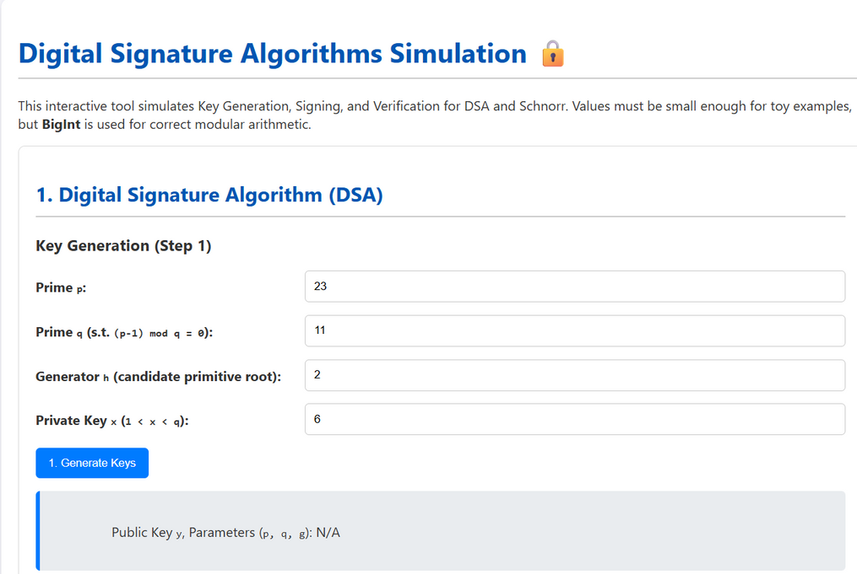
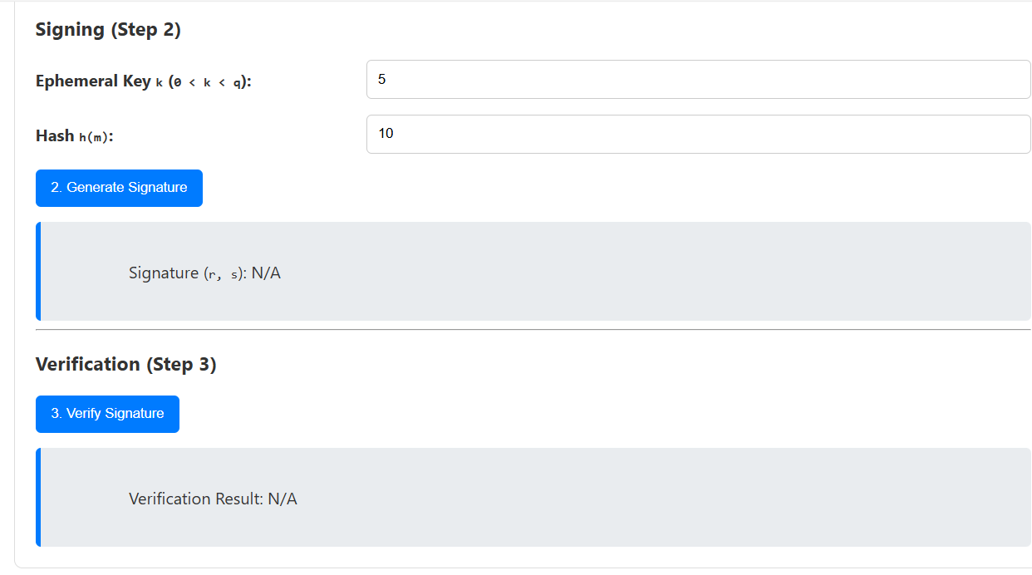
screenshots of implementation

Slide 7
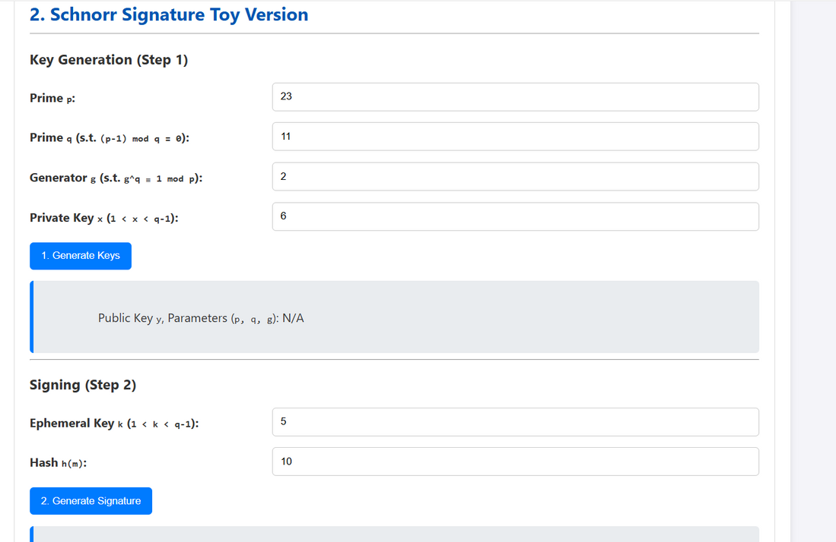
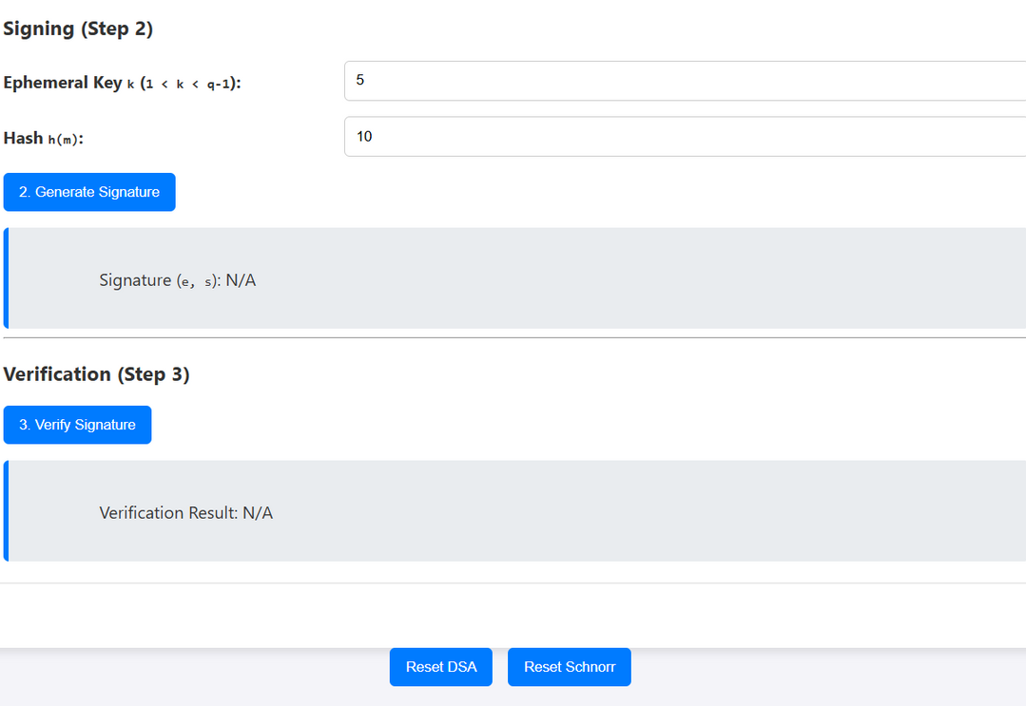
screenshots of implementation

